Slide 1
BusIness OrIented ArchItecture (BOA)
Ömer Yanar
Center of Excellence Lead
Architecht Information Systems and Marketing Trade Inc.

Slide 2
Agenda
Banking System
Business Modules Landscape
Technology
Architecture
Engines
Standards & Compliance
Performance Benchmark Scores
Software Factory Automation
EOD, BCP
KT Bank Germany Implementation
Future Vision
Q&A

Slide 3
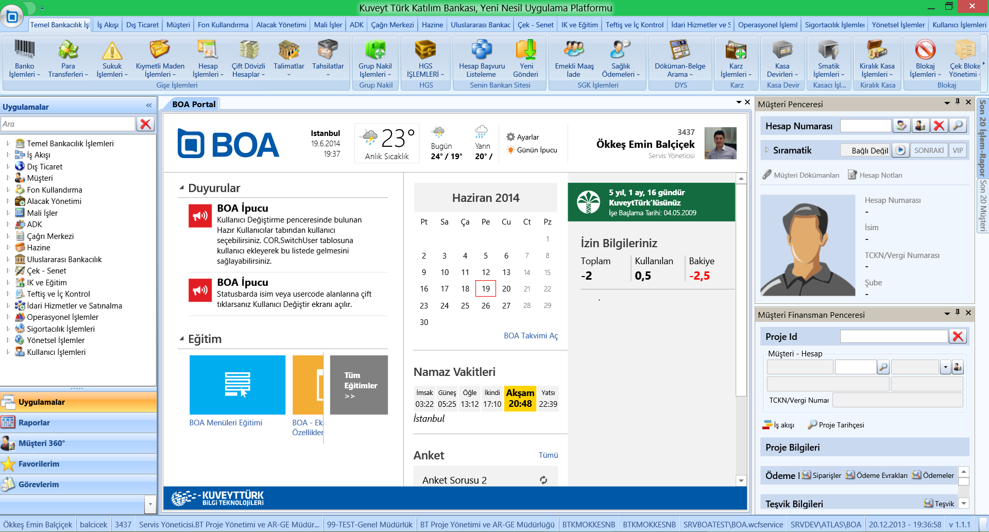
Complete Banking System

Slide 4
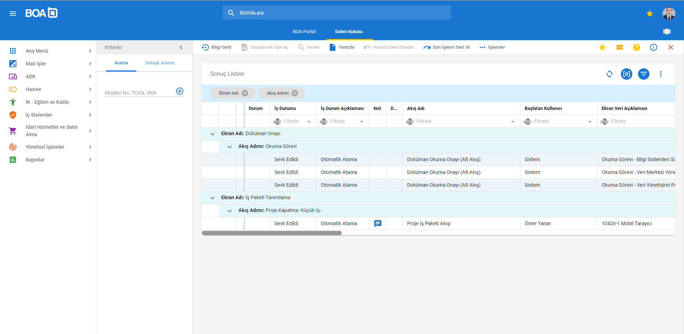
Complete Banking System

Slide 5
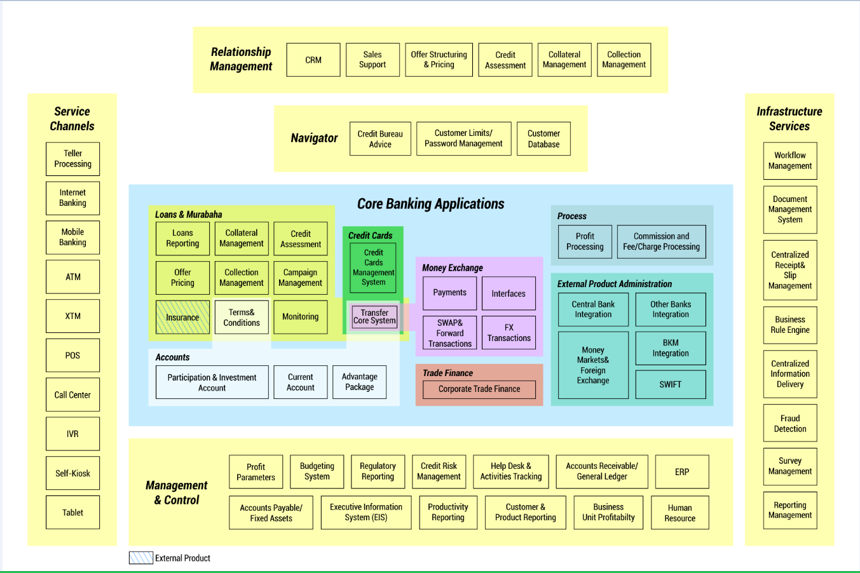
Kuveyt Turk Modules Landscape

Slide 6
Current System in Numbers
Figure | Total
Customers | 3.000.000+
Customer Accounts | 9.258.000
Core Tables | 3000+
Core Stored Procedures | 12.500
Channels | 48
Business Actions | 7.000
Resources (Screens) | 2.600
Daily Transaction Count | ~1.500.000
Daily App. Server Hits | ~25.000.000
Projects in Source Control | ~20.000

Slide 7
BOA (Business Oriented Architecture)
10 months of design and development process
Just enough architecture, more enough business
Simple, Performant, Scalable, 3 tiered architecture
Atomic business components reused in Orchestration and Process layers
A unique approach: Automated transaction management
Standardized code generation (Code Generator for Developers)

Slide 8
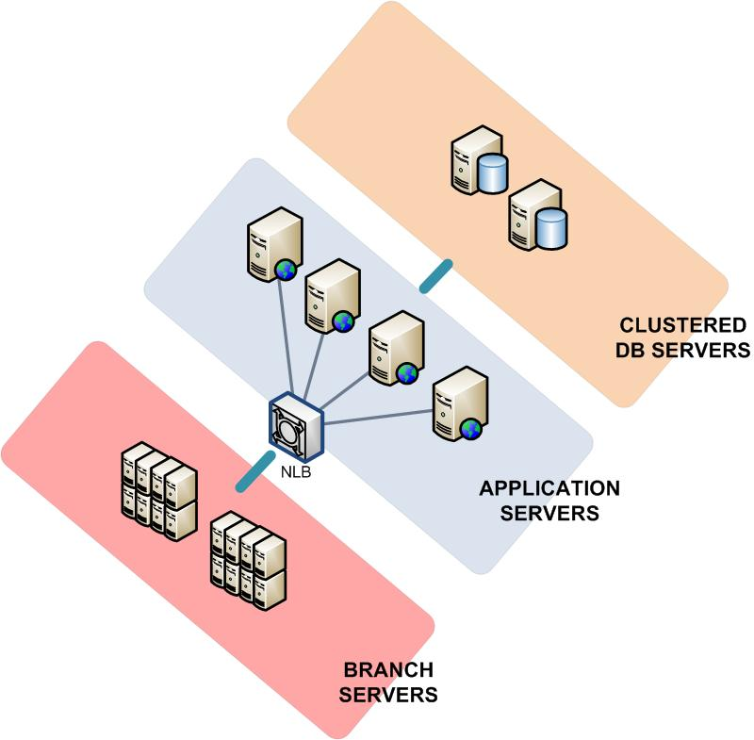
Scalable and Fault-Tolerant 3 Tier Architecture

Slide 9
Technology
.NET Framework, .NET Core
WPF (Desktop), ASP.NET + React (Web)
WCF, REST API
WAS (Windows Process Activation Service)
Visual Studio .Net
Microsoft Azure Devops
Windows Server
SQL Server
Citrix Netscaler NLB
F5

Slide 10
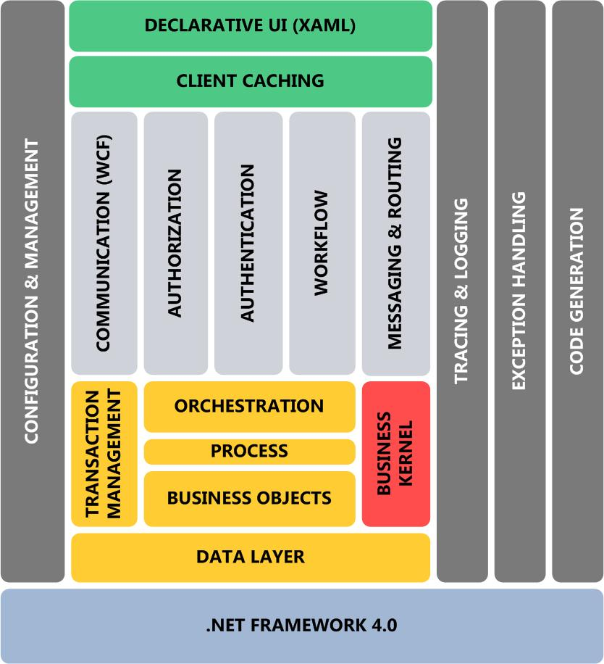
BOA Architecture

Slide 11
Why WPF?
Utilize hardware and OS resources
Strong binding capabilities
Next generation rich user experience
Declarative programming
Flexibility of user controls (Listbox, Tooltip)
Style and theme management made easy
Good career path for developers
Microsoft’s New UI Approach is based on WPF

Slide 12
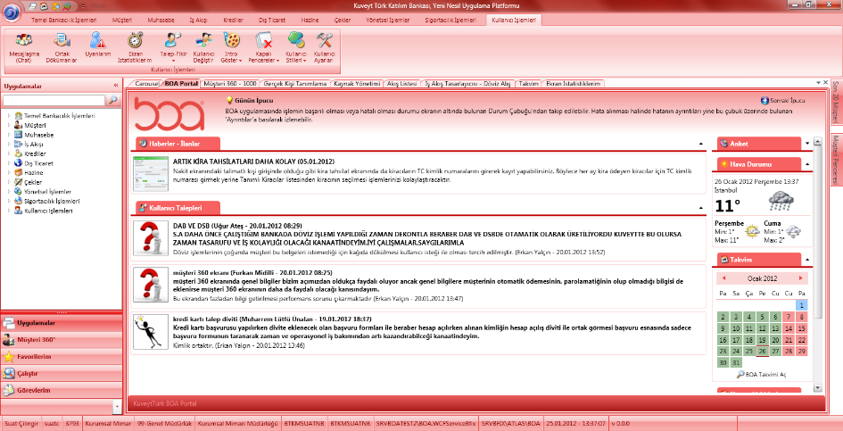
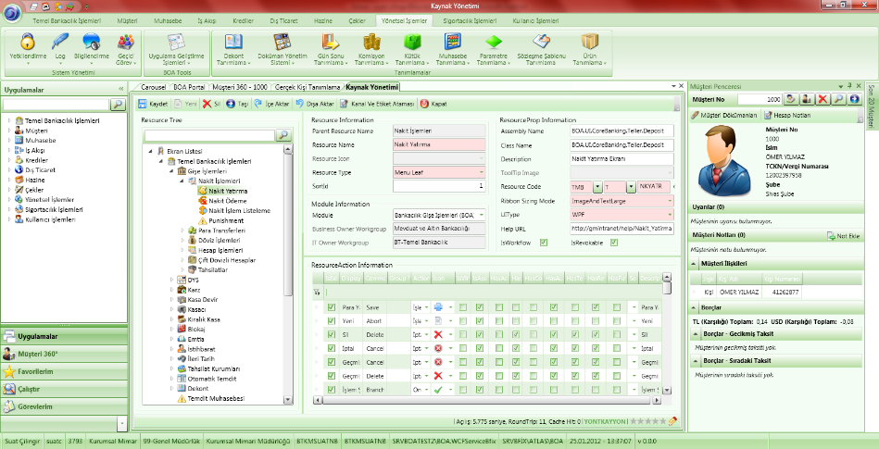
The Container (Desktop)
3 Levels of Navigation Support (Ribbon, Carousel, Tree Menu)
Fully Customizable Screens
Floating Windows
BOA Portal (Welcome Window)
Last 20 Transactions
Last 20 Customers
My Favorites
My Duties
Quick Access Toolbar

Slide 13
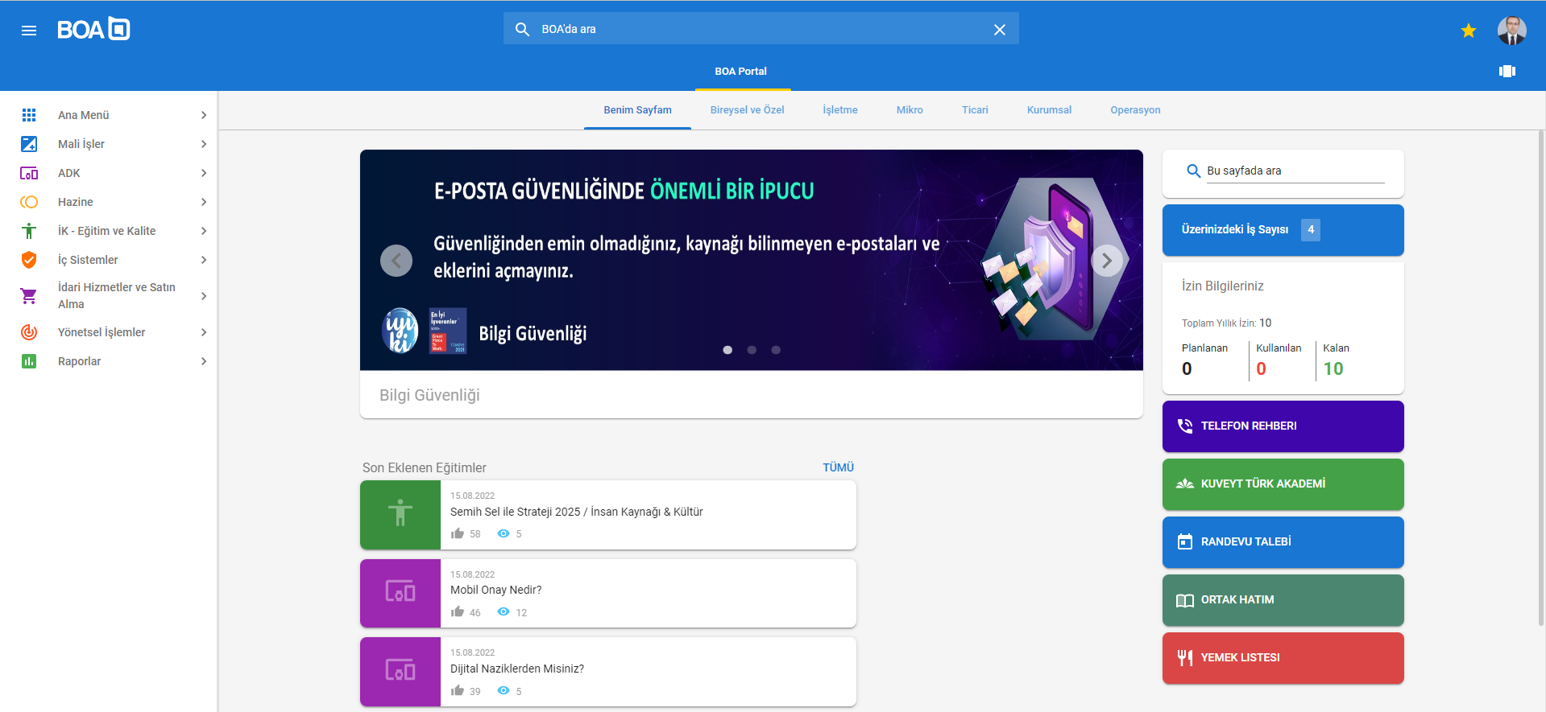
The Container (Web)

Slide 14
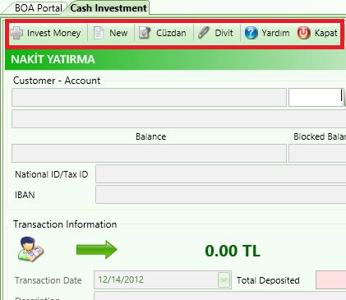
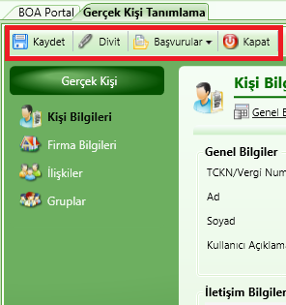
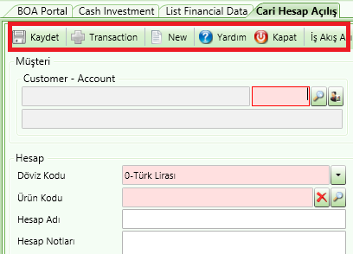
Automated Generation of Toolbar and Command Buttons (Actions)
The toolbar is generated dynamically according to the rights of the current user
Actions, rights and relationship with the screens are fully declarative
Even Workflow actions are generated accordingly
Command pattern for the button clicks
Save
SaveCommand
Delete
DeleteCommand
Close
CloseCommand

Slide 15
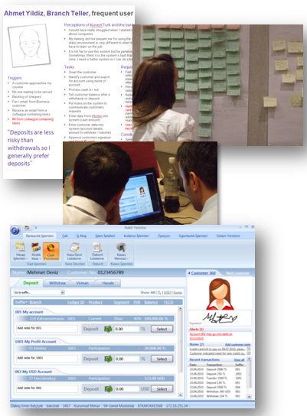
User Experience Studies
User Experience and Ergonomy Study with Microsoft and BunnyFoot in Oxford
Ergonomy Assessment with the Academic World (Prof. Dr. Fethi Çalışır)
Result: User-Centric Design Methodology for UIdesign

Slide 16
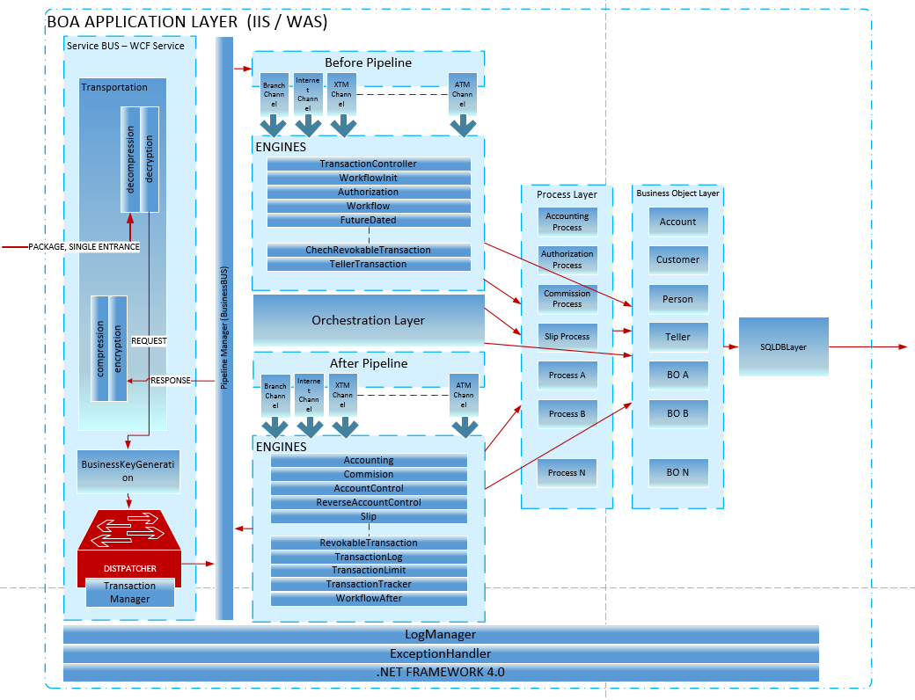
Application Server – Service Bus Topology

Slide 17
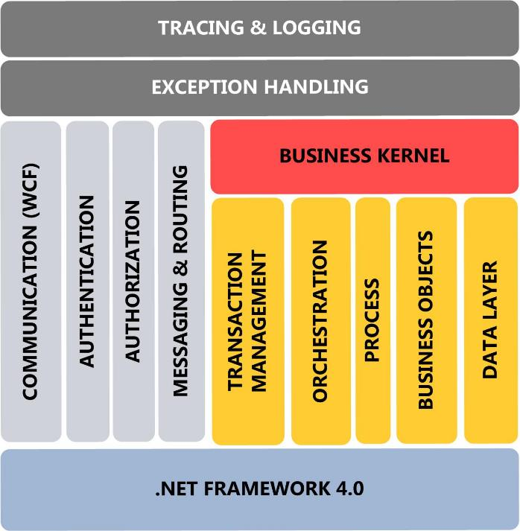

Request/Response Communication
NonTransactionalRequest (default)
TransactionalRequest (suitable for transactional requests)
MultipleRequest (suitable for batch requests. decreases round-trips.)
MultipleTransactionalRequest (suitable for batch transactional requests)
encryption
compression
BOA Request
decompression
decryption
UI
UI
decryption
decompression
BOA Response
compression
encryption

Slide 18
BOA Engines
Commission Engine
Accounting Engine
Slip Engine
Transaction Cancellation Engine
Account Exception Engine
Workflow Engine
Banknote Engine
Authorization Engine
Information Engine
Rule Engine
Parameterized Slip Definitions w/o Manual Coding
Parameterized Commission Definitions w/o Manual Coding
Definition based (Change without coding)
Plugin model (Easily add/remove)
Developer friendly model (Minimum code to implement)
Auto integrated to each request
Channeld based pipeline
Orchestration
Process
Business Kernel
Parameterized
Workflows w/o
Manual Coding
Parameterized
Accounting Definitions w/o Manual Coding

Slide 19
Engine Execution Order
MESSAGE PARSING
Branch
Amount
INTERNAL RULE ENGINE
If Customer Profitability >10
DYNAMIC EVALUATION AND DATABASE OPERATIONS
Assembly Generation
Dynamic Evaluation
DB Operations
PROCEED TO NEXT ENGINE
Customer
Account
LedgerId
...
Return Commission Amount = 50
If Customer Belongs to Advantage Package
Return Commission Amount = 10
Caching

Slide 20
Business Key – BOA’s «National ID»
200912010099001310010000001 ->Did Balance Inquiry
200912010099001310010000001 Did Balance Inquiry ->Did Table Insert
200912010099001310010000001 Did Balance Inquiry Did Table Insert ->Did Accounting&Commission
Every request stamped with a unique 27 digit key
Tracking the journey of request through layers
Execution Tree
No request allowed without a business key

Slide 21
Client+Server+Database Logging, Journal
Client Errors + Performance
Application Server Errors + Performance
Database triggers BOALOG
Logging at Every Layer
4 levels of logging
All business transactions are serialized to Journal
Balance Inquiry
Table Insert
Accounting
Journal

Slide 22
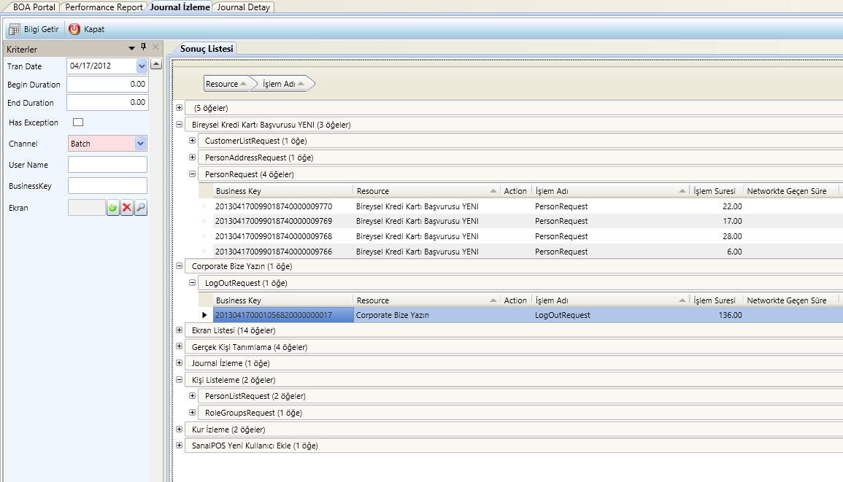
Tracking/Monitoring the Journal
Tracking user /channel / screen request
Tracking any window’s requests

Slide 23
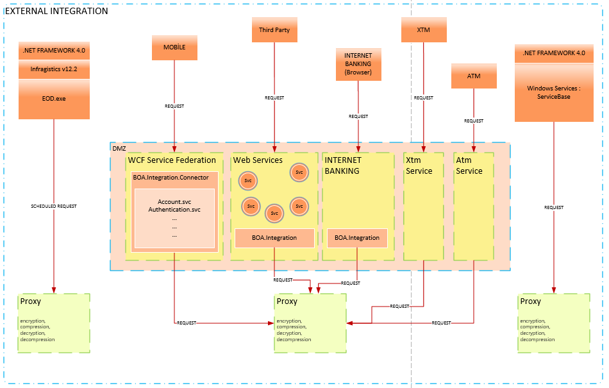
External Integration

Slide 24
Fraud Detection System
Fraud Engine
Detects fraudulent transactions of employees and customers Analyzes abnormal internet branch transactions to find fraud operations
Analyzes call center employee actions to find suspicious persons
Analyzes customer actions to find suspicious transactions
Fraud Windows Service
Fraud Subsystem
Fraud Definition
Fraud Detection
Fraud Tiger Team

Slide 25
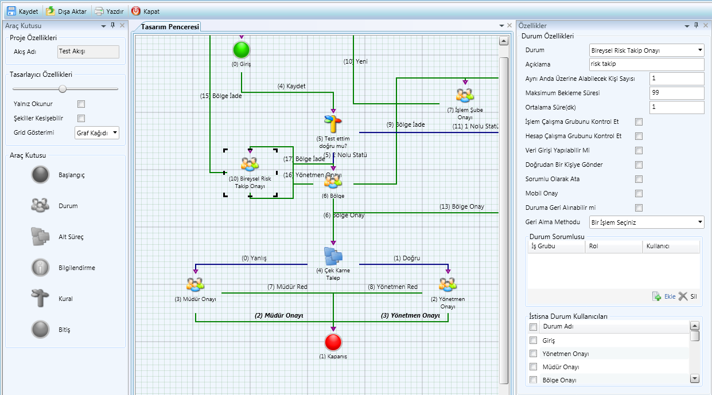
Integrated Workflow with Full Designer Support
Fluent user friendly designer
Fully integrated to transactional system
Sub Flow Mechanism
Auto Assigning based on rules
Easily History Tracking

Slide 26
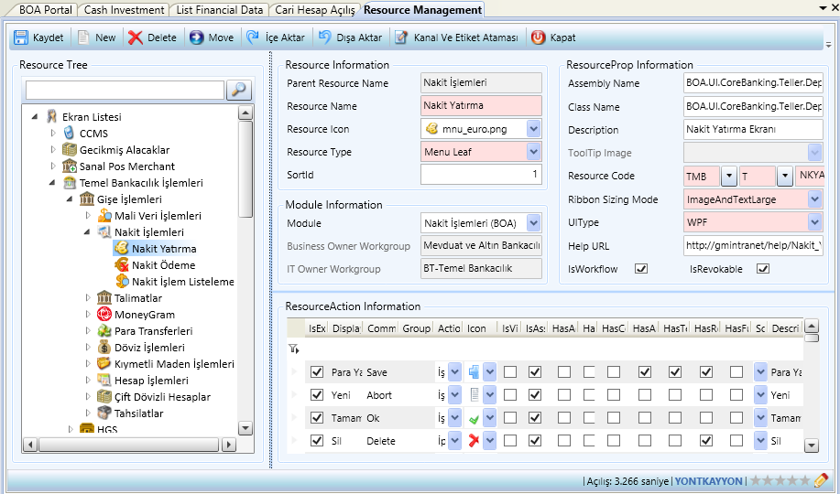
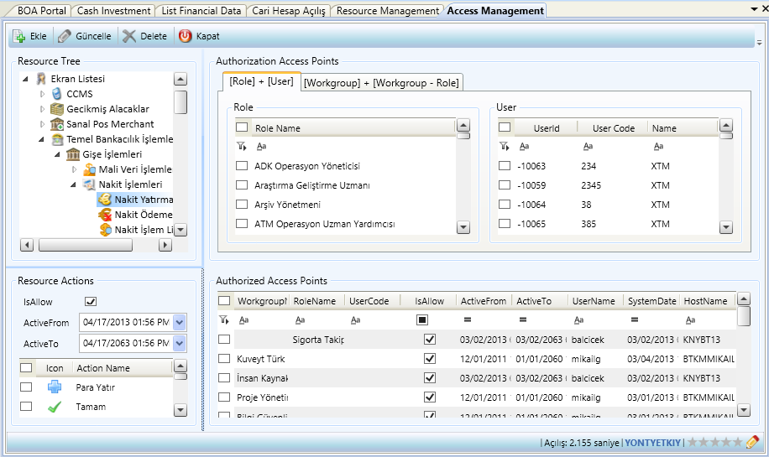
Centralized Authorization System
Every Window is a Resource
Every Button is an Action
Action Based Authorization
Authorization For Workgroups, Roles and Users

Slide 27
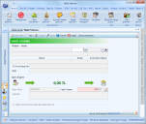
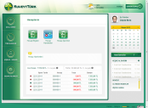


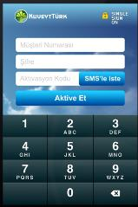
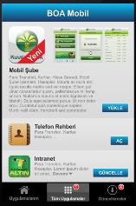
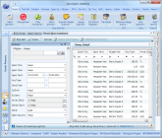



Centralized Business Services
| Channel
BOA Container
BOA Internet
XTM
EOD
BOA Mobile
Resource
Internal Money Transfer
Deposite
Internet Branch Change Password
Business Service Pool
Hundreds of centralized business services flows through 48 Channels and 6000 Screens

Slide 28
Information Engine
Third Parties and Other DBs
BOA COMMUNICATION
DEFINITION
INSTANCE
BOA COMMUNICATION JOURNAL
COEX
E-MAIL
E-MAIL QUEUE
E-MAIL QUEUE
SMS
COEX
SMS QUEUE
SMS QUEUE
Push
COEX
BOA Alert
Push QUEUE
Push QUEUE

Slide 29
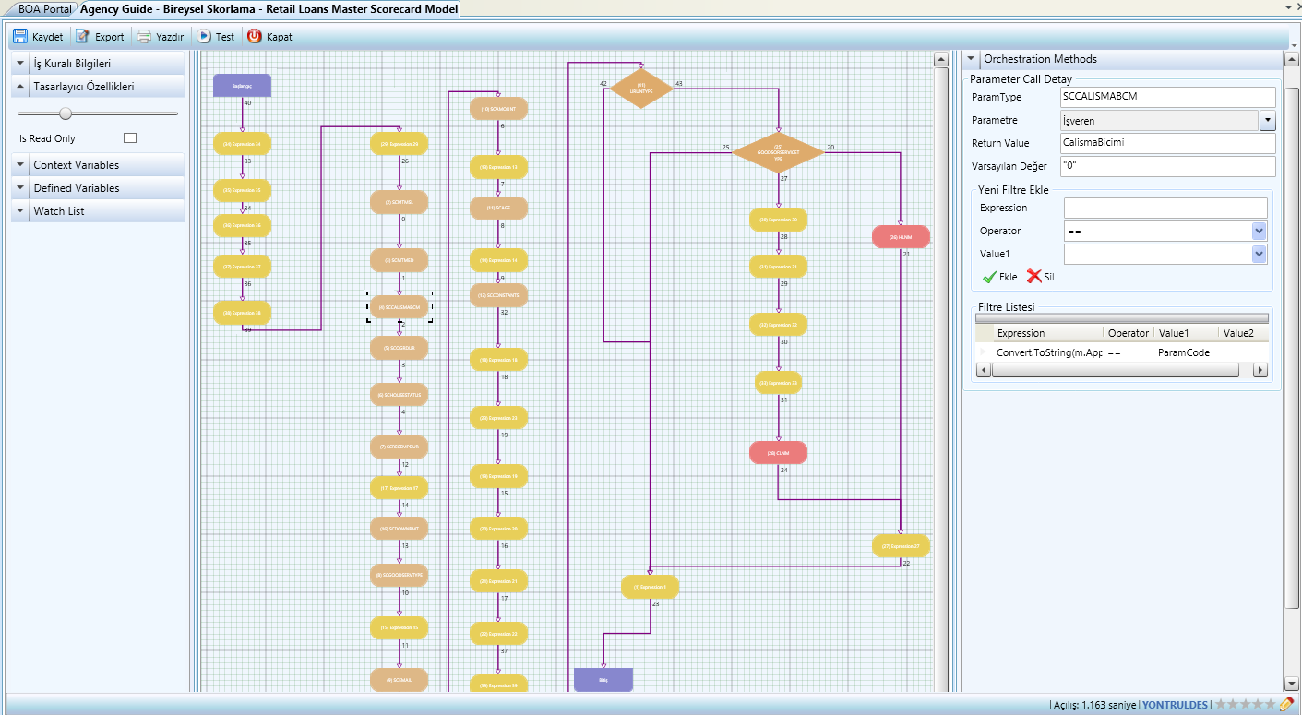
Rule Engine
Framework embedded
Tightly Coupled and Loosely Coupled rules
No integration needed
Can use BOA Kernel Libraries

Slide 30
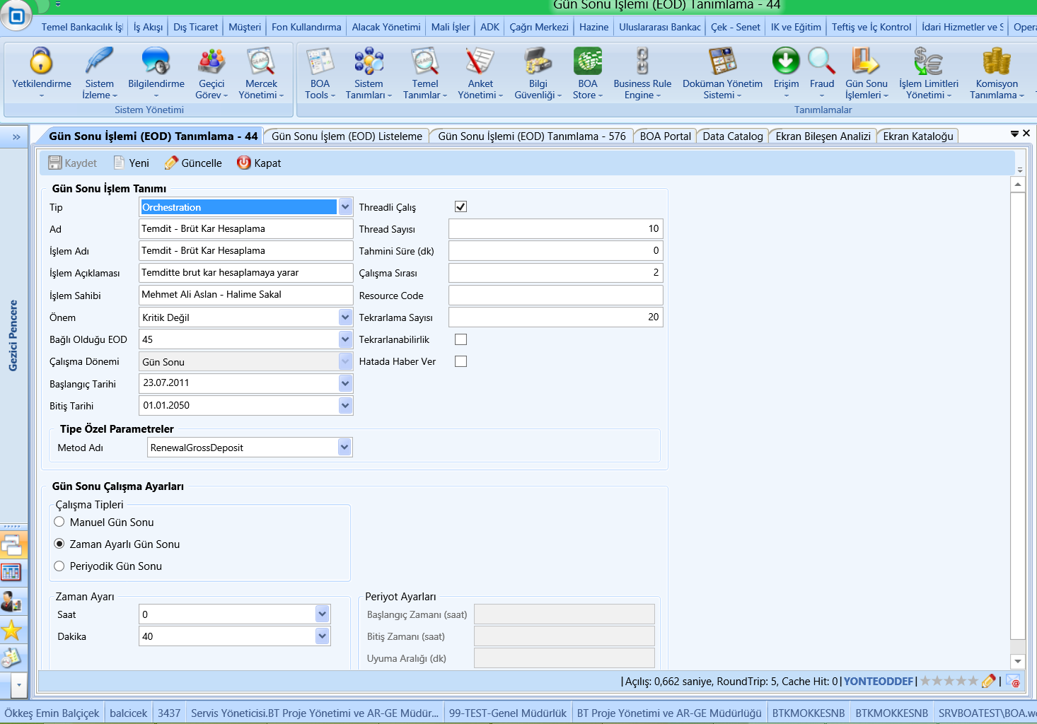
Batch Transactions (EOD) Management

Slide 31
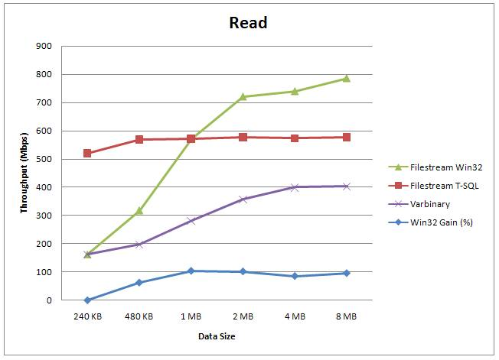
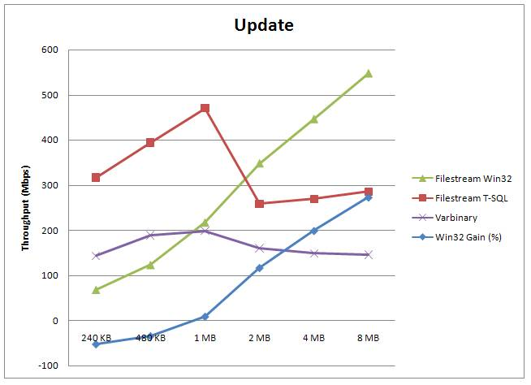
Filestream Technology
Infrastructure for the New Generation Integrated Document Management System
Reduced Costs and Better Performance
Ensuring Transactional Integrity for Document Management Operations
Integration with Transactional System

Slide 32
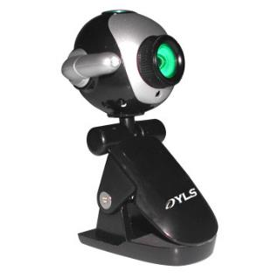
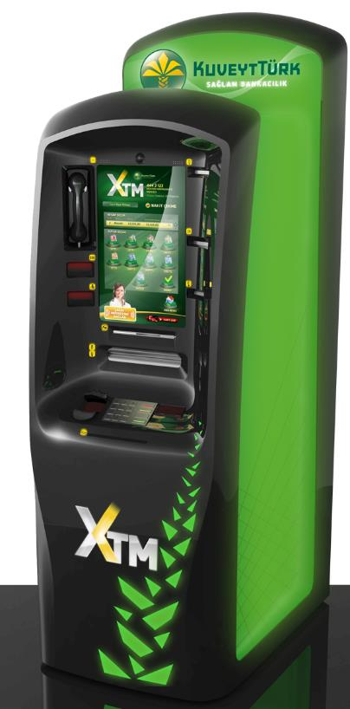
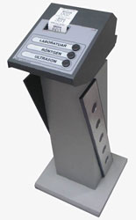
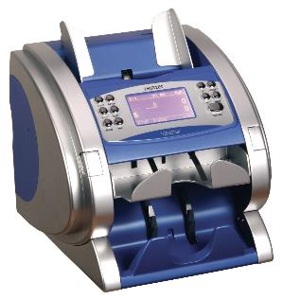
Rich Device Integration
Smatic – Ticket Machine (Numerator)
iHunter (Cash Counter Machine)
Camera Integration For Customer Photos
XTM

Slide 33
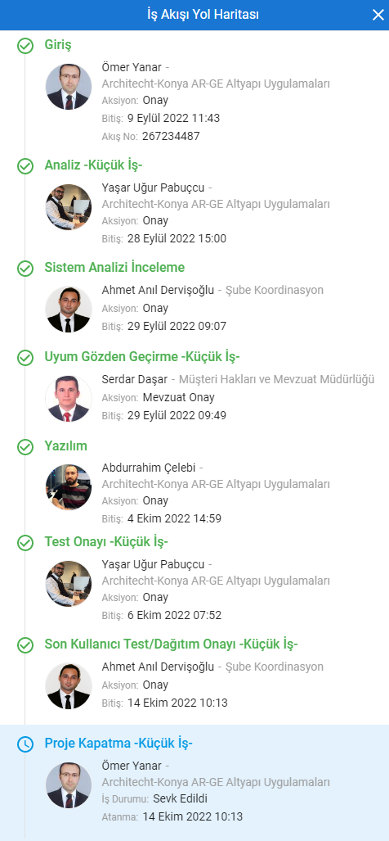
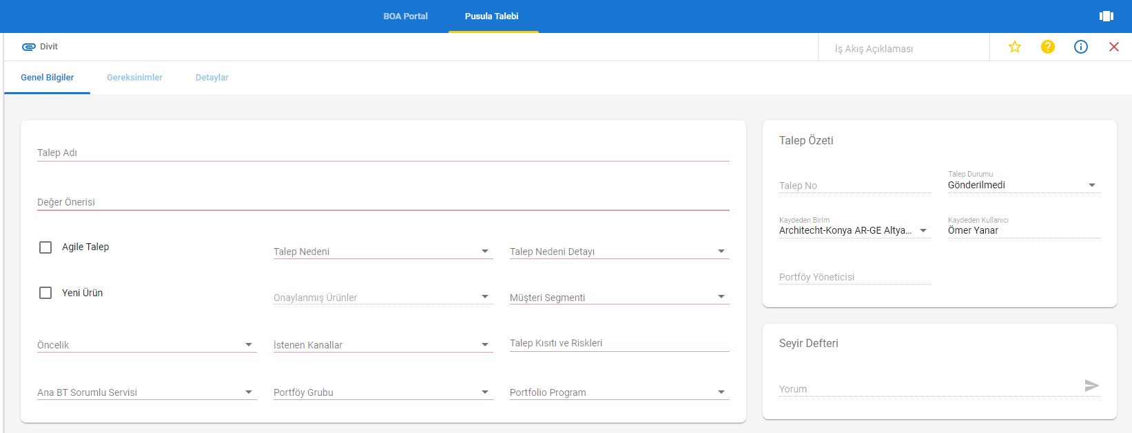
Demand & SDLC Management

Slide 34
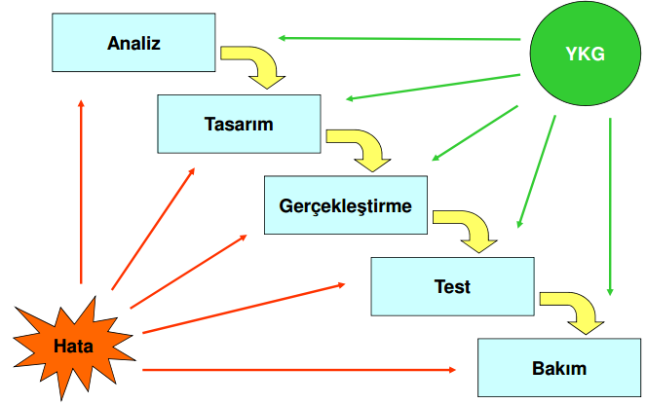
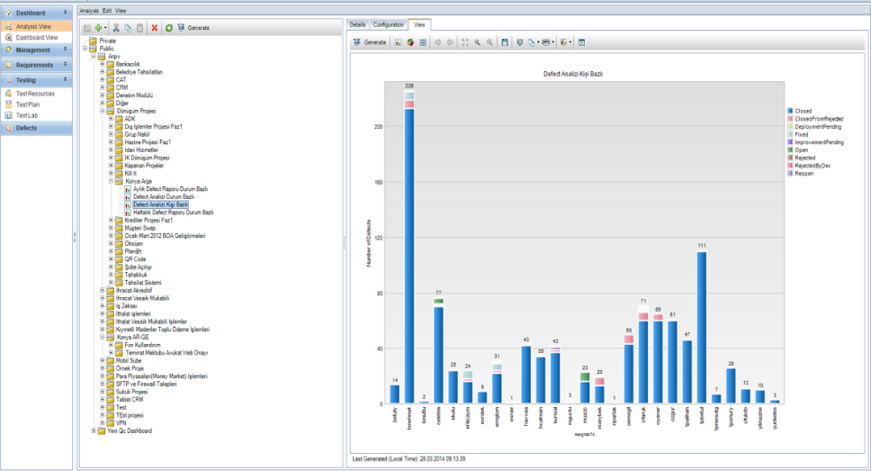
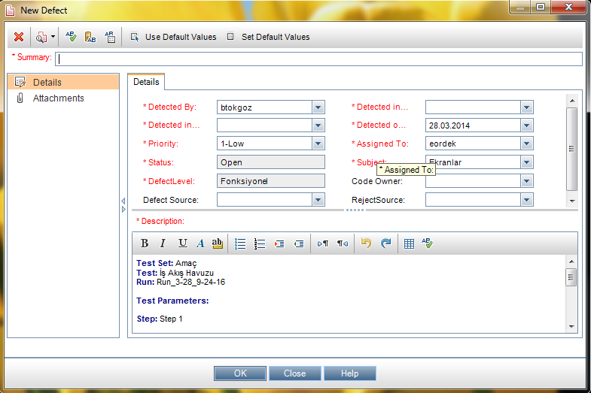
Software Quality Assurance

Slide 35
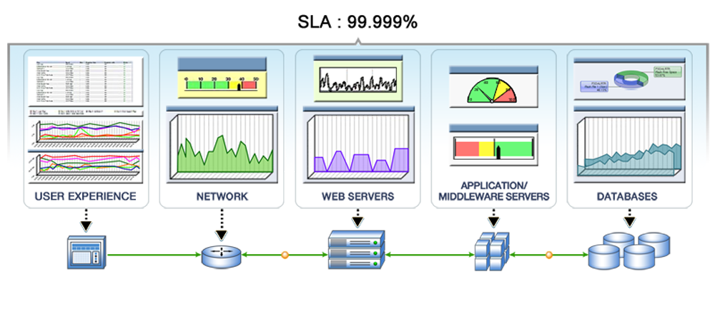
Adoption to ITIL Processes
Synthetic Transactions Channel for Diagnostics and Monitoring
Performance and Service Interruption Management

Slide 36
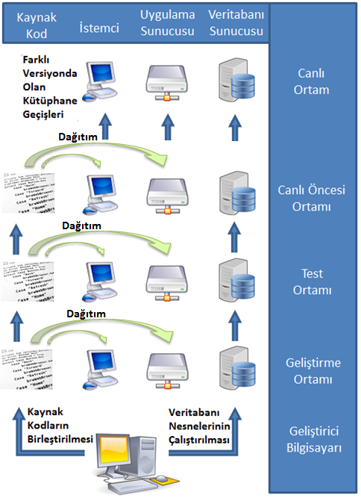
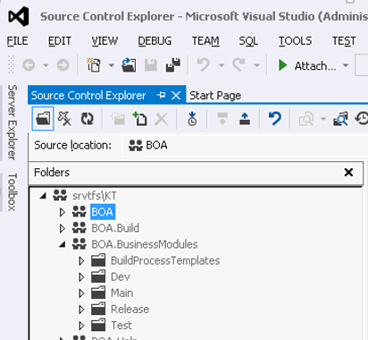
Application Production Line

Slide 37
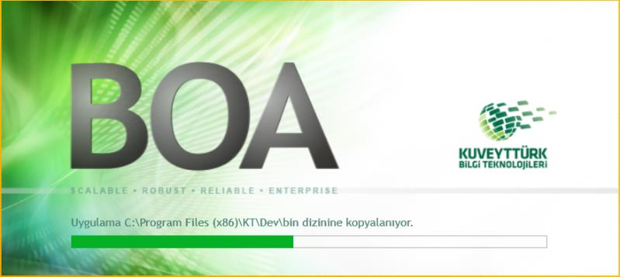
Push/Pull Models for Deployment
Deployment Service
Operations Center
General Management
Branches
Flexible package deployment
Per branch deployment
Build & Deployment Automation
Change Management Automation using BOA Change Management

Slide 38
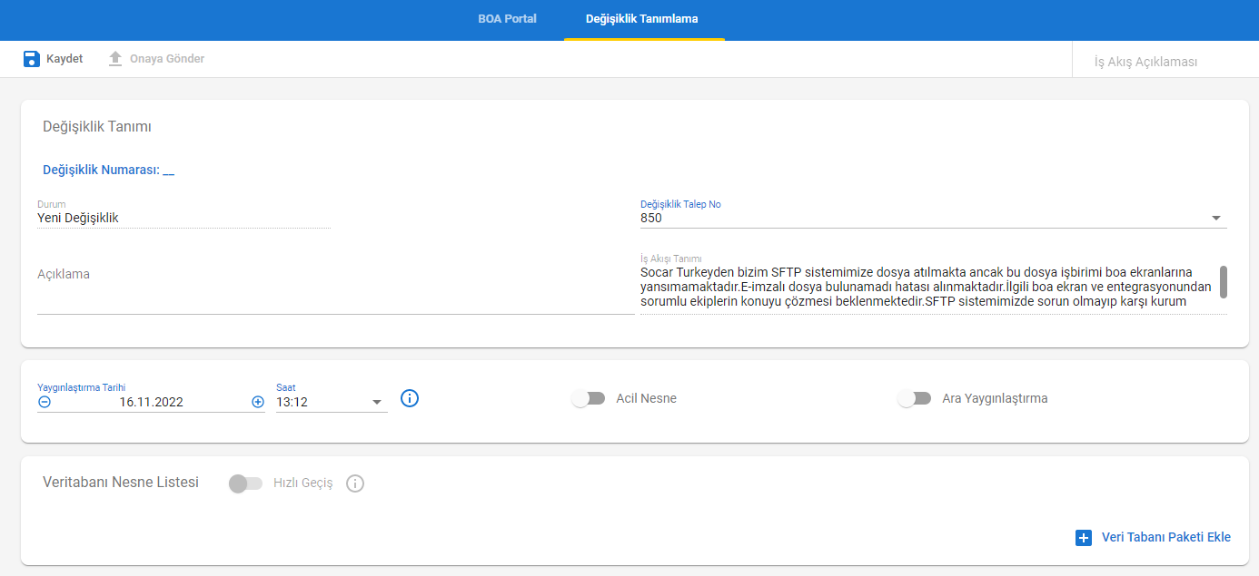
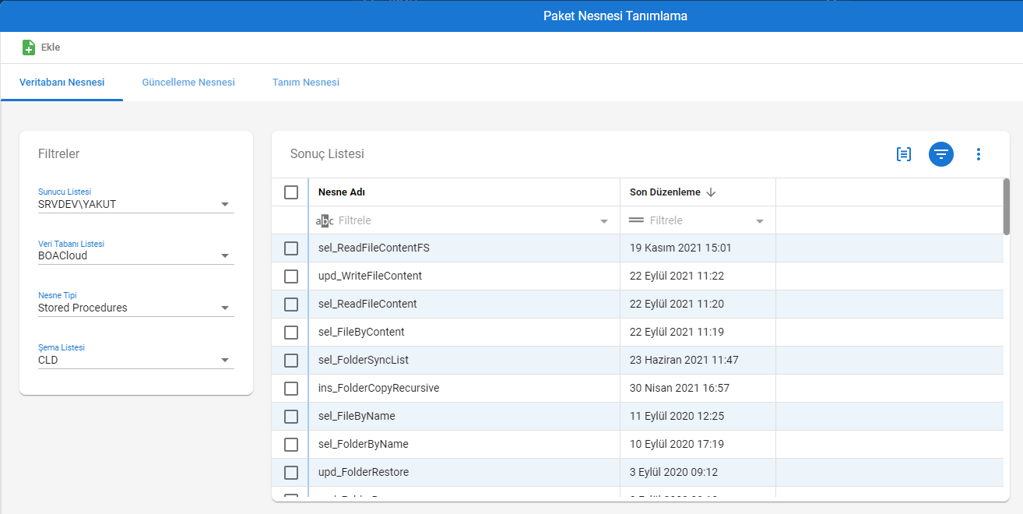
BOA Change Management

Slide 39
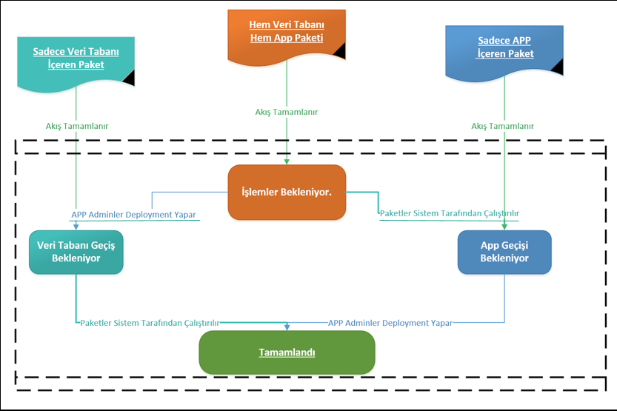
BOA Change Management

Slide 40
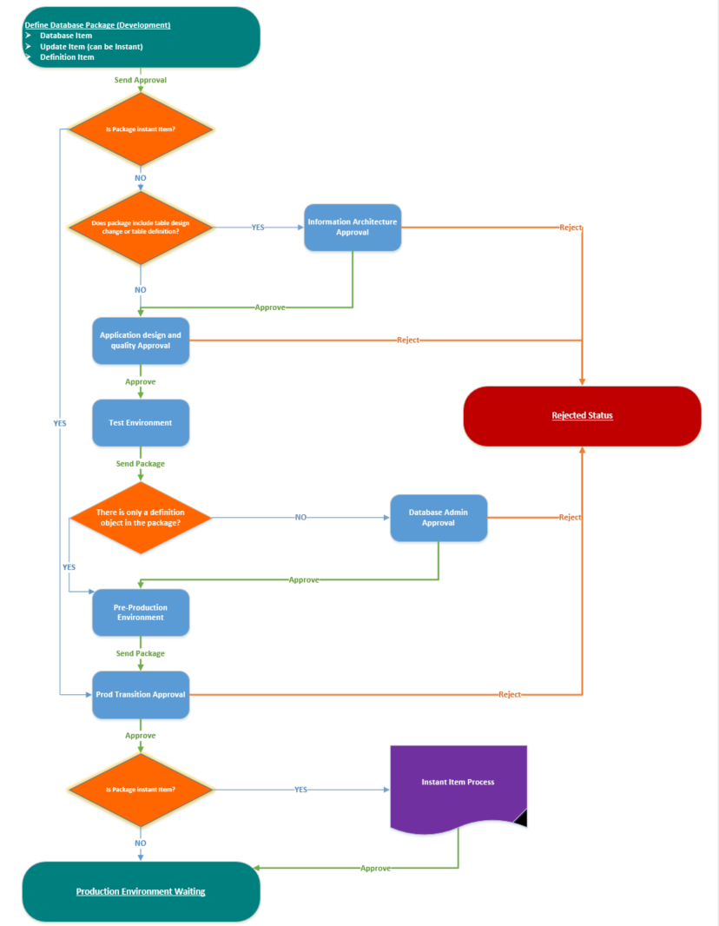
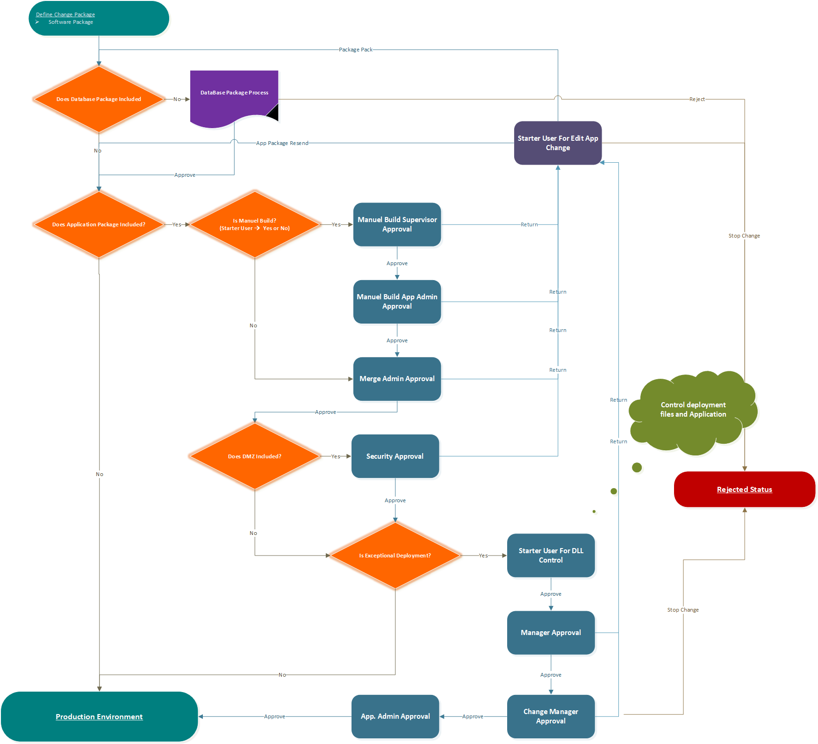
BOA Change Management

Slide 41
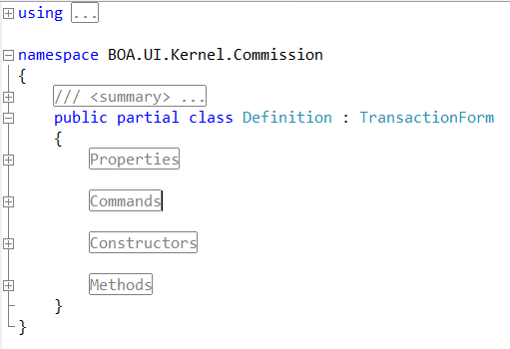
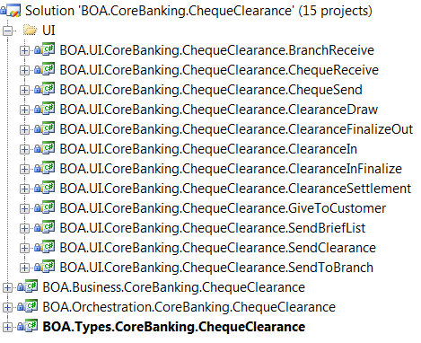
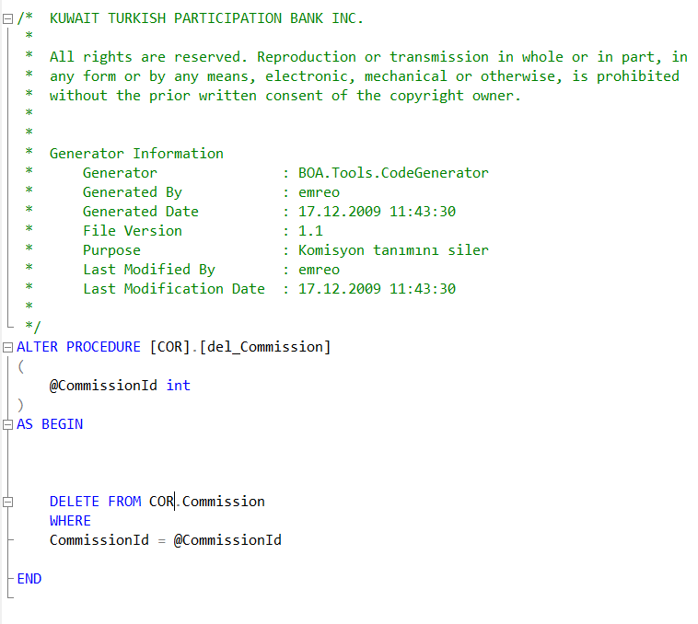
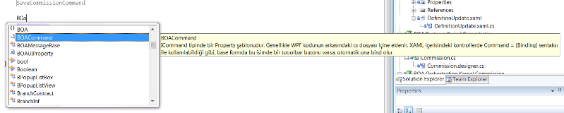
Standards Ensured At Every Level
Standard Solution Structure
Standard Coding Blocks
Standard Snippets
Standard Stored Procedures

Slide 42


Preset Project and Form Templates for Developer
Project Templates
Business
Orchestration
Types
UI
Form Templates
Browse Form
Transaction Form
Transactional Browse Form

Slide 43


Automated Code Generation at Every Level

Slide 44


Documentations and Videos

Slide 45



End-to-End Transaction Performance Metrics
Any request-anywhere
Durations
Execution Tree
Request content and Response content

Slide 46




Performance HealthCheck Reports and Alerts
Performance Report Screens
Daily Emailed Performance Report
Daily Emailed Consistency Report
Daily Emailed Error Report
Daily Emailed DB Error Report
Daily Emailed Slowest Requests Report

Slide 47
Performance HealthCheck Reports and Alerts

Slide 48

BOA Code Metrics – Maintainability Index
Halstead Volume (V)= N * log2 n
N (Program Length) = Total Operators and Operands, n = unique operators and operands
Green (good) : 20 - 100
Yellow (so so) : 10 - 19
Red (bad) : 0 - 9
Project | * Maintainability Index | Cyclomatic Complexity | Depth of Inheritance | Class Coupling | Lines of Code
BOA.Base | 75 | 207 | 2 | 60 | 503
BOA.BusinessBus | 78 | 1100 | 2 | 143 | 3778
BOA.Common | 92 | 6954 | 6 | 357 | 8136
BOA.Common.Constant | 95 | 16 | 1 | 5 | 33
BOA.Integration | 83 | 39 | 1 | 19 | 79
BOA.Orchestration | 66 | 1026 | 1 | 388 | 3361
BOA.Process | 43 | 405 | 1 | 83 | 1420
BOA.Proxy | 80 | 86 | 2 | 55 | 236
BOA.ServiceBus | 77 | 199 | 3 | 105 | 496
BOA.UI | 82 | 2117 | 13 | 434 | 4505
BOA.UI.Business | 93 | 1541 | 11 | 365 | 3581
BOA.UI.Business.Customer360 | 100 | 0 | 1 | 0 | 0
BOA.UI.Common | 95 | 67 | 1 | 25 | 132
BOA.UI.Container | 77 | 476 | 3 | 207 | 988
BOA.UI.Exceptions | 95 | 16 | 4 | 3 | 16
BOA.UI.Resources | 89 | 76 | 1 | 22 | 106
BOA.UI.Splash | 100 | 1 | 1 | 0 | 1
BOA.WCFService | 82 | 10 | 1 | 4 | 28
BusinessObjects\BOA.Business.Internal | 57 | 256 | 2 | 59 | 1862
BusinessObjects\BOA.Business.Kernel | 56 | 1155 | 2 | 191 | 6903
BusinessObjects\BOA.Business.Security | 56 | 107 | 2 | 42 | 611

Slide 49

BOA Application and Source Code Analytics

Slide 50
Munich Benchmark
October 2009
8 Application Servers (Total 68 cores), 1 SQL Server (16 cores, 60 GB RAM)
2,950 Financial Transactions/sec
36,000 SQL Transactions/sec
Avg. Response Time: 30 ms.

Slide 51
Seattle Benchmark
March 2010
49 Application Servers (552 Cores), 1 SQL Server (48 Cores, 128 GB RAM)
14,200 Financial Transactions/sec
102,000 SQL Transactions/sec
Avg. Response Fime: 20 ms.
World Record

Slide 52


Coexistence Methodology
Immediate/Delayed Synchronization
Both systems coexisting “Peacefully”
Smooth Culture and Module Transitions
Low burden on resources

Slide 53



Certified in Germany for KT Bank AG
IDW PS 880 Die Prüfung von Softwareprodukten

Slide 54

Thank you
Q & A

